Slide 1




Slide 2
Team Roles
Chris Blistine - React Architect
Csbistline github
Kevin Bailey - Authentication Master
RedSW20 github
Brendan Gutleber - Customer Query Form Validation and API Ninja
GutleberB94 github
Alexandr 'Sasha' Peters - DataBase Guru
Merpig github
Andy Pack - PreDesign, Front End, and ReadMe Monster
ThePackPater github

Slide 3

With special thanks to:
Our Team set out to develop a full-stack Custom Interface for the Franklin Dodge Parts Department. Our goals were to:
Allow a customer to submit an Online Part Request
Auto-Notify the Customer via Text/ Email upon receipt
Create Databases for both the Parts Team and Customer Requests
Create a Portal where the Parts Team can login to their personalized Dashboard
Assign Customer Requests to Parts Specialists by the Parts Manager
Allow Parts Specialists to create notes once Customer is contacted and complete the order
Send a copy of the completed request to The Parts Manager for review
Match the current Webpage UX design and Follow Component Oriented Development
Sounds pretty simple right?!?

Slide 4
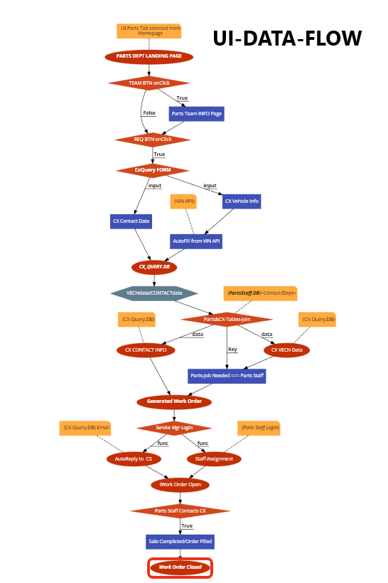
Well here’s our initial data map…..

Slide 5
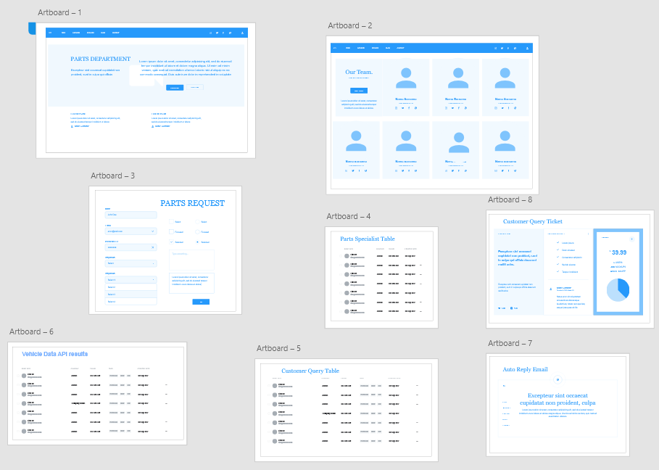
We designed some wireframes...

Slide 6
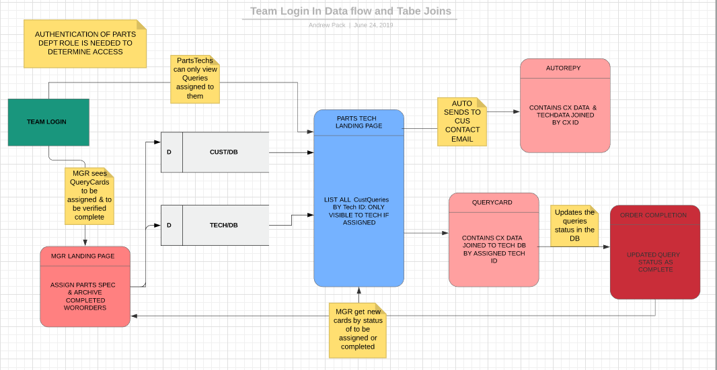
We got a little more specific with the data...

Slide 7
Then We Started Coding!

Slide 8
Technologies Used
Mongo - Used for Database
Express - Used for routes, to handling requests, and views
React - JS framework
Node - Used for developing server-side and networking
React-Bootstrap - Used to generate front end styling
Github-ProjectMgr - Used to assign roles, set benchmarks, manage code flow
Adobe - Used to generate design wireframes
LucidChart - Used to generate Login DataFlow
Code2Flow - Used to generate App Data flow chart
Axios - Used for API calls
Heroku - Used for App deployment
MessageBird - Used to generate text confirmation
NodeMailer - Used to generate autoReply Email
Unirest - Used in API call to verify Vin Data
Bcrypt - Used for Authentication
Passport - Used for Node.js Authentication
Moment - Used for Tracking query lifecycle

Slide 9
Let’s DEMO!

